Slide 1
mobile eda

Slide 2

CHANGE AFTER AND BEFORE 5G

Slide 3
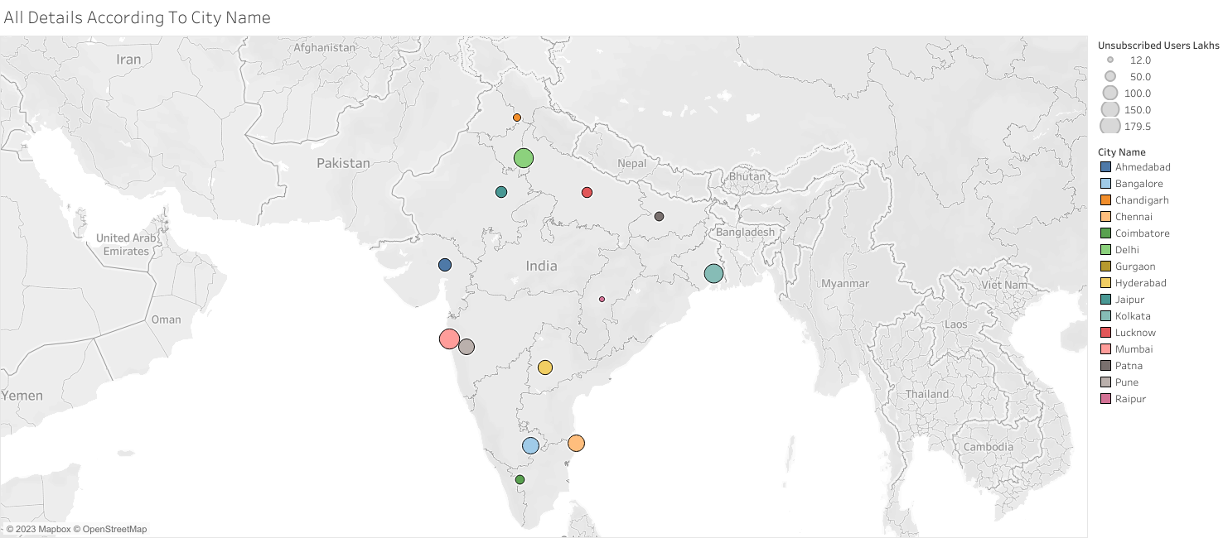

Slide 4
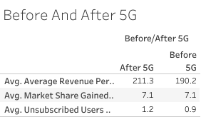

Slide 5
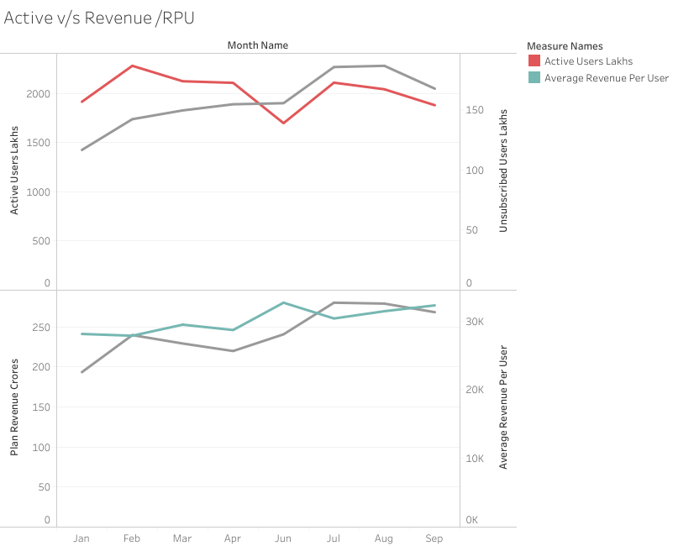

Slide 6
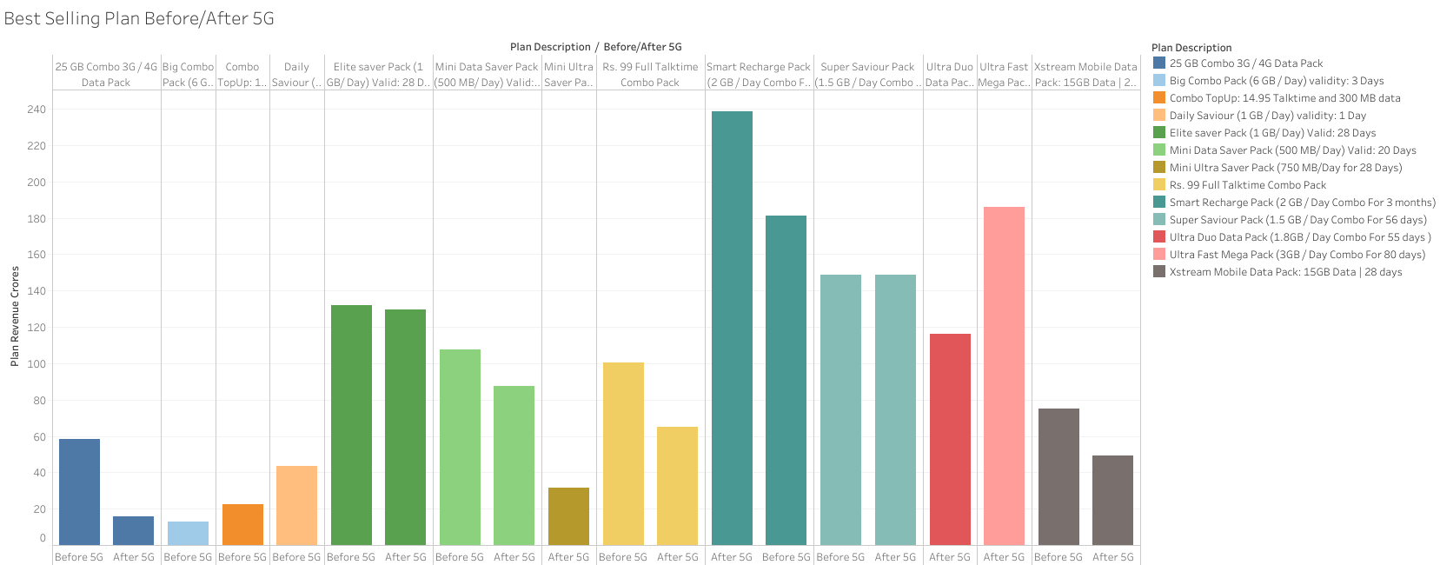

Slide 7
